Slide 1
Notes:
Hi, welcome to this orientation to Transition Services offered through the Division of Rehabilitative Services…or DRS.
The purpose of this orientation is to help you understand DRS’ vocational rehabilitation…or VR program…and how it may help youth with disabilities in their transition from school to adult life.

Slide 2
In this orientation…
Division of Rehabilitative Services
How VR can work for you?
What services are available?
How to apply for VR services?
Who is eligible for VR services?
Why VR is important in transition planning?
Notes:
Here are some of the topics that we will explain in this orientation.
How VR can work for you
What services are available
How to apply for VR services
Who is eligible for VR services
Why VR is important in transition planning

Slide 3
How is VR involved in Transition Services?
Primary focus of DRS
Federal and state program
All school divisions have a VR counselor
Notes:
So…LET’S GET STARTED!
How is VR involved in Transition Services?
Vocational Rehabilitation (VR) is the primary focus of DRS. DRS is a federal and state program that works with people who have disabilities to help them gain or retain employment. Our VR Counselors are assigned to all Virginia school divisions to support students with disabilities as they prepare for employment. So what should you do if you are interested in VR?
.

Slide 4
The VR Process
Referral
Employment
Plan
Success!
Eligibility
Application
Assessments
Notes:
These are the steps and I’ll explain each of them to you…referral, application, eligibility, assessments, and employment plan. Following this process will help guide you to success!

Slide 5
The Referral Process
Referral to DRS may be made by
The student
The student’s family or guardian
School personnel
Community based service providers
Notes:
First, let’s talk about the Referral Process. Generally, referrals to DRS are made by the individual, a parent or guardian, or school staff. Other community-based service providers may assist you as well, such as health professionals or disability organizations. After the referral occurs, a VR Counselor will contact you.

Slide 6
Applying for Services
Meet with a VR Counselor
Complete the Application for VR Services
* Parent or guardian signature needed if under 18 yrs old
Notes:
Next, you will need to complete an application for services.
Your VR Counselor will assist you and your family to discuss the application process by having an Intake Interview where you will meet with the VR Counselor to discuss how your disability may impact your ability to work. If you choose to apply, you will complete some initial paperwork including the Application for VR Services. If you are under age 18, your parent or guardian will need to sign the Application. The application and the intake interview will give the VR Counselor information to determine if you are eligible for services.

Slide 7
Criteria for Eligibility
Must:
Have a physical or mental disability that keeps you from getting or keeping a job
Need VR services for an employment outcome
Be legally eligible to work in the United States
Be present in Virginia
Notes:
To be eligible for services, a person must meet these criteria: They must have a physical or mental disability that keeps them from getting or keeping a job;
must need VR services for an employment outcome; must be legally eligible to work in the United States; and must be present in Virginia.

Slide 8
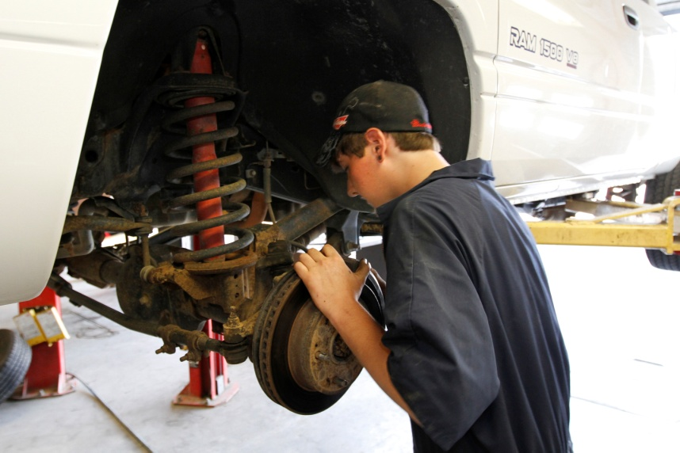
Assessments
Employment possibilities
Strengths, preferences, interests, and needs
Work skills
Make an informed choice!
Notes:
Your VR Counselor may need to have you participate in assessments to discover what your employment possibilities are.
Assessments will help you and your counselor learn more about your strengths, preferences, interests, needs, and work skills and help you make an informed choice about your employment options.

Slide 9
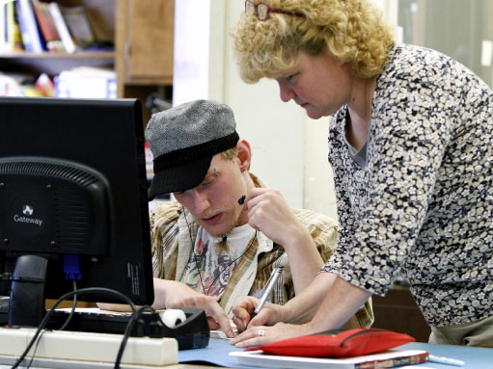
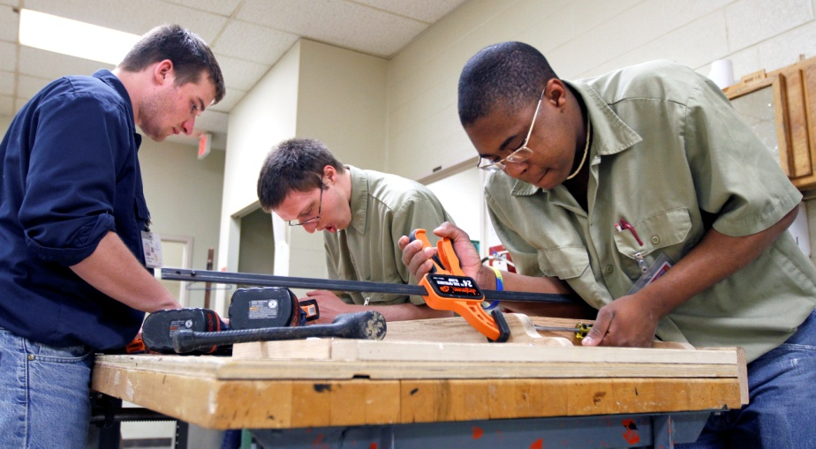
Assessments
At DRS office or school
Hands-on
Determined mutually
Notes:
A variety of assessments may take place at your local DRS office or at school. On-site assessment may be arranged to provide hands-on experience or you may be offered an opportunity to participate in a comprehensive assessment such as the Postsecondary Education Rehabilitation Transition…or PERT…program at the Wilson Workforce and Rehabilitation Center. Needed assessments are determined mutually between you and your VR Counselor. After the assessments are completed, you and your VR Counselor can work together to create your Individualized Plan for Employment….or Employment Plan.

Slide 10
Individualized Plan for Employment
Written document to outline:
Employment goal
Steps and timeframe
Responsibilities
Services
Training
Supplies
Accommodations
Notes:
The Employment Plan is a written document outlining a specific employment goal and contains detailed steps and time frames, mutual responsibilities, needed services, training, and supplies as well as any disability-related accommodations. Your Employment Plan may have several services that will be decided between you and your VR Counselor. These may include:

Slide 11
Services
Career Guidance and Counseling
Assistive Technology
Career Exploration
Job Development
Vocational Evaluation and Assessment

Slide 12
Services
Job Shadowing
Job Placement
Training and Education after High School
On-the-Job Training (OJT)
Job Coaching

Slide 13
Social Security / Government Benefits
Do you have SSI or SSDI benefits?
Do you have food, housing, or medical assistance?
Work Incentive Programs are available
Work Incentives Specialists will help you
Maximize your income!
Notes:
Another important aspect of your school to work transition may be your use of Social Security benefits. You may wonder if employment will affect your current government benefits such as SSI, SSDI, food or housing assistance. By using available work incentive programs through the Social Security Administration you will have more monthly income than if you were to depend solely on disability related benefit programs. Your VR Counselor will discuss these work incentives with you and can direct you and your family to service providers called Work Incentive Specialists. They have extensive training in this area and can answer questions about how going to work can maximize your income.

Slide 14
Tips for You and Your Family
Start early!
Advocate for yourself!
Stay active!
Communicate with your counselor!
Ask questions!
Notes:
Here are some additional tips for you and your family….
Start Early! Learn about DRS, meet the VR Counselor who covers your school and discuss when you should apply. Then Advocate for Yourself! Learn self determination skills and practice them. You can find out more about this topic from Virginia’s I’m Determined Program. Also Stay active in your planning and communicate with your counselor! Initiate communication and participate in meetings and appointments that are about you. And Ask Questions! What resources may help you? What can you do to help in the process? What can you expect of DRS and your transition team?

Slide 15
Planning for the future should not be done for you but instead with you.
Many community partners may work with you.
Notes:
Remember, DRS is one of many resources available to help you in your transition years. Decide if VR will work for you and get involved in the process to determine your future.
Get to know your local DRS office and the VR Counselor assigned to your school! For more information visit our website at www.vadars.org or call us at 800-552-5019 today!

Slide 16
Contact us
Visit our website at www.vadars.org
View Virginia’s DRS Transition Guide at http://www.vadrs.org/transitionservices.htm
Call us at 800-552-5019

