Slide 1
Project ABLE
Advocates Building Livable Environments
October, 2013 through March, 2015

Slide 2
I. Evolution of the project design

Slide 3
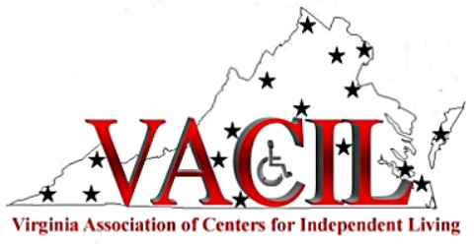
The Concept…
“The Virginia ABLE project envisions a comprehensive systemic approach to significantly increase the knowledge, skill, and expertise of builders, building inspectors/officials, engineers, architects and design professionals in the area of the Americans with Disabilities Act Accessibility Guidelines, and Fair Housing laws.”
“The project is intended to provide a major expansion of skill and knowledge among Virginia building professionals in a manner that will establish both immediate and long term training that will incorporate and inculcate accessibility and universal design concepts and requirements.”

Slide 4
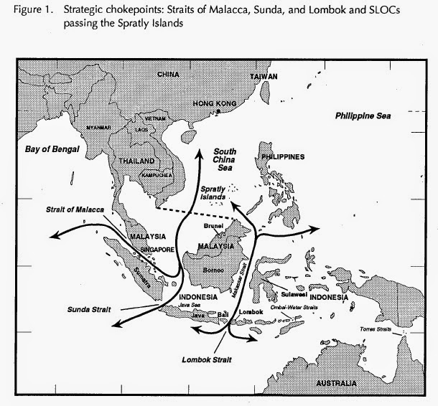
The key element…
…attacking the “chokepoint”.

Slide 5
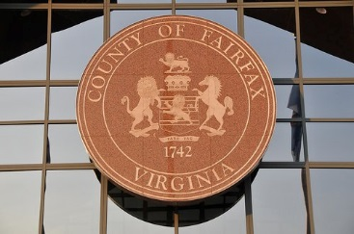
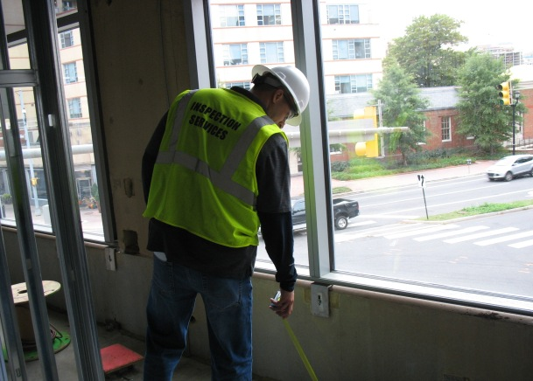
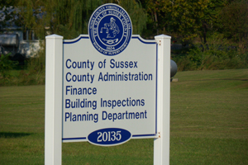
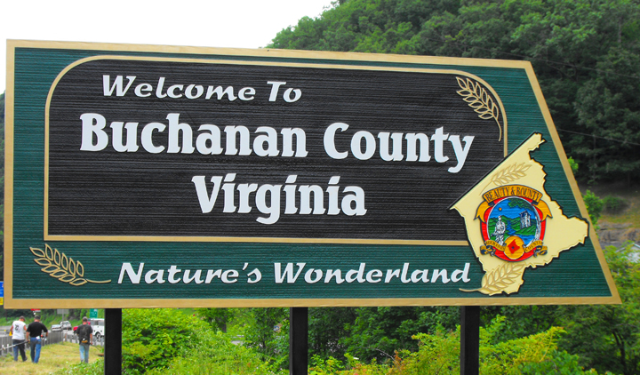
Project ABLE’s defined “chokepoint” target: Virginia’s building inspections operations.

Slide 6
Assumptions:
The massive scope of an effective outreach effort to the majority of private sector building professionals makes such an initiative impractical within the financial and time parameters this grant.
Building inspections offices, however, provide a critical nexus between governmental regulation and private sector development.
The dissemination of desired information at the “chokepoints” of the building inspections operations offers the opportunity of a significant “spillover” effect among private sector building professionals.
Establishing and enhancing the interaction of building inspections offices and the CILs advocacy network provides a significant long term opportunity for continual systems advocacy on a statewide basis.

Slide 7
II. Implementation

Slide 8
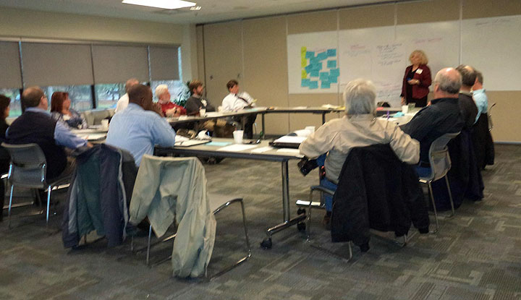
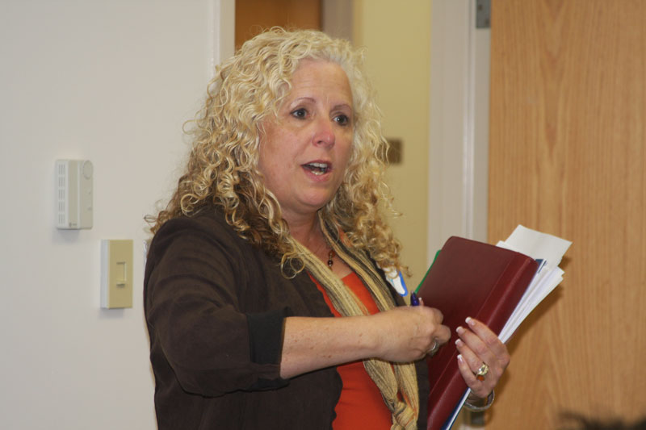
Identifying the issues:
*the focus groups*
Locations: Charlottesville (2), Richmond, Fairfax (2)
Composition: 85 building professionals and 21 individuals with disabilities
Organization: use of professional moderator/facilitator, Becky Clay-Christensen

Slide 9
Analysis of the data:

Slide 10
Clarifying the data:
Follow-up interviews with selected building inspections professionals
“What are your particular challenges with accessibility standards?”
“What are the most frequent accessibility issues that you address?”
“What would make your job easier?”
Survey of available resource and training materials

Slide 11
Required key design elements:
Ease of use
Relevance of material
Explanatory comments and analysis
Simultaneous viewing and comparison of all three codes/standards
Online presence and ease of broad dissemination
Capability of expansion and revision
Developmental issues:
No similar document existed in the literature
Scope was restricted to 12 topics of high concern

Slide 12
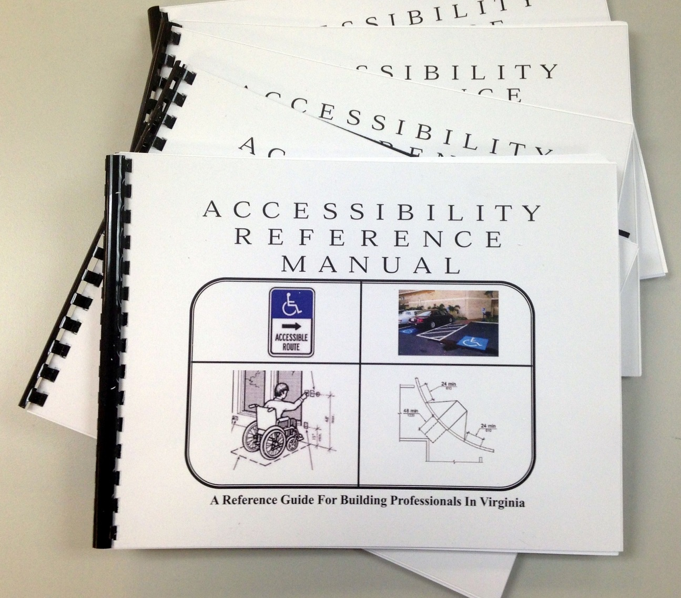
The Development of the
“Accessibility Reference Manual
for Virginia Building Professionals”

Slide 13
Building blocks…

Slide 14
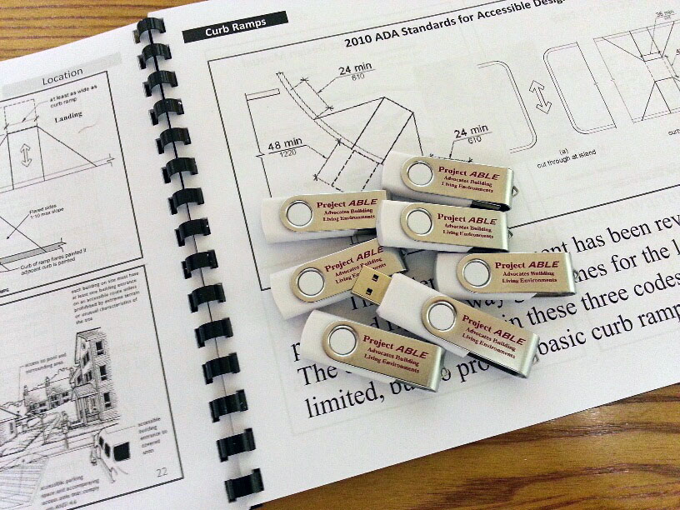
The Flash Drives
Contents:
The “Accessibility Reference Manual” in PDF format
ICC 1111.1-2009 (AINSI)
Fair Housing Design Manual (Parts 1 & 2)
2010 ADA standards

Slide 15
Training of “Chokepoint” Advocates:
Review and examination of the three codes/standards
Explanation and examination of the “Accessibility Reference Manual” and the flash drives
Explanation of goals of the “chokepoint” advocacy initiative
Presentation of tactics for interaction with building inspections officials

Slide 16
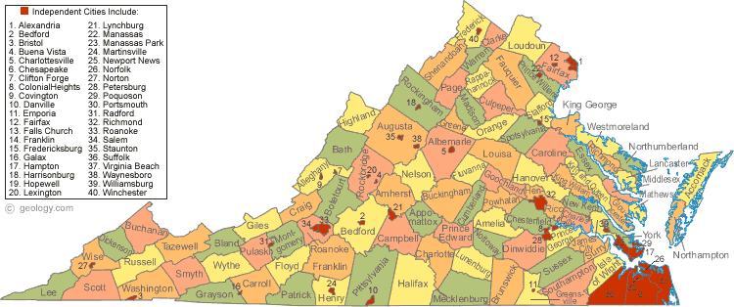
Project ABLE’s choke point advocacy initiative:
35 CIL advocates trained 277 Virginia building code officials
in 138 jurisdictions in six weeks

Slide 17
Key Elements in Training
of Building Inspections Officials
Initial introductory letter and explanation of the project (138 jurisdictions)
Follow-up phone communication to make training appointment (at convenience of building inspection officials)
Emphasis on “making job easier” for building inspections personnel
Explanation and distribution of the material (“Access Reference Manual” and the flash drive)
Review of ADA and universal design principles
Discussion of legal exposure for local jurisdiction
Discussion of CIL network as a resource for the building inspections operations
Discussion of particular accessibility issues and interests of the jurisdiction

Slide 18
Training of Building Professionals:
Explanation of the key issue: confusion over the differences in the three codes/standards
Review and examination of the three codes/standards
Explanation and examination of the “Accessibility Reference Manual” and flash drives
Presentation of the CIL advocacy and expertise network
Questions and answers

Slide 19
III. Update, Evaluation, and Future Plans

Slide 20
Update:
At this point 600 copies of the “Accessibility Reference Manual” have been printed and distributed, as well as 250 flash drives.
146 private sector building professionals were trained in using the manual, etc.
277 building inspections officials in 138 Virginia jurisdictions have been trained in using the manual, etc.
Major impacts: broad statewide systemic advocacy effort; linkage between CIL network and building inspections offices.

Slide 21
Strengths:
Development of useful and popular unprecedented resource material for Virginia’s building professionals
Creation of an advocacy model that can be replicated and/or expanded
Development of a unique online resource that can be revised and expanded in the future
Provision of critical resource materials and training to Virginia building code officials
Establishment and expansion of collaboration between Virginia’s CIL advocacy network and Virginia’s building code operations
Increased enforcement and application of accessibility standards statewide
Weaknesses:
Limited scope of research materials (only12 primary topics)
Limited direct outreach to other building professional groups (architects, private sector builders, etc.)
Limited ability to expand knowledge of ADA standards among building inspections officials
Limited ability to incorporate reference materials in curriculum of professional training institutions (e.g., architectural schools)

Slide 22
Future Plans:
Development of ADA curriculum designed for building inspections officials
Expansion of dissemination of reference and training materials to other building professional groups
Enhancement and expansion of online reference material
Legislative effort to merge accessibility standards into existing building code
Development of hyperlinked online 2010 ADA Guidelines document and other standards/codes

Slide 23
And a very special thanks to VBPD
for making it all happen!

